Slide 1
Adaptive Personal Cooling System
Luka Miljanov (N01624502) & Michael McCorkell (N01500049)
MENG-2530-0NA, Microcontrollers
April 22, 2026

Slide 2
Project Overview
The Problem
Nearly 500,000 deaths annually from hyperthermia; core temps above 40 °C are a medical emergency
Bedridden, elderly, and ill individuals have diminished thermoregulatory responses (sweating, vasodilation)
Standard fixed-speed fans cannot respond dynamically to changing thermal conditions
What is the APCS?
A prototype embedded system that continuously measures ambient temperature and automatically adjusts fan speed via PID control
Built on the TM4C123GH6PM (ARM Cortex-M4F) microcontroller; interfaces DS18B20 sensor, potentiometer, fan, and I²C LCD
Main Objective
Provide automated, responsive personal cooling that adapts in real time — something a conventional fan cannot do

Slide 3
Design Requirements & Goals
Performance Targets
Regulate ambient temperature within ±1–2 °C of the user-selected setpoint (20–60 °C range)
Control loop update rate: ~2 seconds; DS18B20 12-bit resolution (0.0625 °C/step)
Fan response from setpoint change to observable airflow: ≤ 3 seconds
Constraints
Platform: TM4C123GH6PM LaunchPad; toolchain: Keil MDK-ARM with CMSIS device pack
Components: off-the-shelf only (DS18B20, 10 kΩ potentiometer, 4-wire 12 V PC fan, I²C LCD)
Firmware in 8 modular C files; no wireless, no battery, no multi-sensor architecture
Success Criteria
PID controller converges to setpoint, fan operates without stall, LCD provides real-time feedback
System gracefully recovers from sensor loss without requiring a hard reset

Slide 4
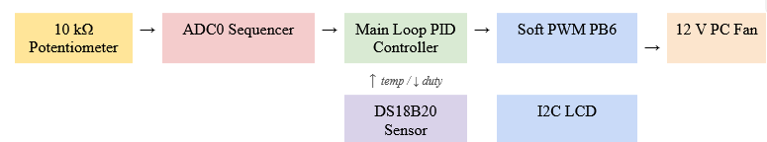
Design Process & Architecture
System Block Diagram
Potentiometer → ADC0 Sequencer 3 → Main Loop PID Controller → Soft PWM PB6 → 12 V PC Fan
DS18B20 (1-Wire, PE1) feeds temperature into the PID; I²C LCD (PB2/PB3) shows live status
Firmware Architecture (8 modules)
main.c — control loop; adc.c — potentiometer; ds18b20.c — 1-Wire driver; pwm.c — fan drive
pid.c — discrete PID with anti-windup; lcd.c — I²C display; delay.c — SysTick timing; utils.c — string helpers

Slide 5

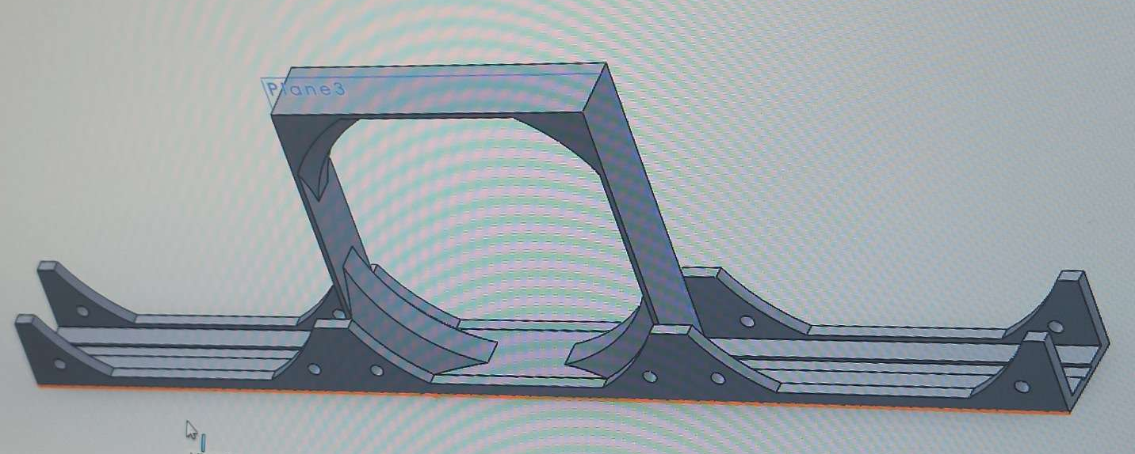
Design Process & Architecture
Hardware Design
SolidWorks rail mount bracket for the PC fan; 3D-printed enclosure with removable lid houses LaunchPad, LCD, and wiring
Potentiometer and LCD accessible through front-panel cutout

Slide 6
Build Process & Components
Key Components
TM4C123GH6PM LaunchPad — 80 MHz ARM Cortex-M4F, 256 KB flash, 32 KB SRAM
Dallas DS18B20 — ±0.5 °C accuracy, 12-bit resolution, 1-Wire interface on PE1
10 kΩ linear potentiometer — maps 0–3.3 V to 20–60 °C setpoint via ADC0
4-wire 12 V PC fan — dedicated PWM input; hardware PWM on PB6 at 25 kHz
16×2 I²C LCD (addr 0x28) — real-time display of temperature, setpoint, and duty cycle
Assembly Steps
Breadboard wiring: DS18B20 on PE1 with 5 kΩ pull-up; potentiometer wiper to PE3; fan PWM to PB6
SolidWorks CAD → 3D-print enclosure → mount LaunchPad, LCD, and fan rail bracket
Compile with Keil MDK-ARM; flash via on-board ICDI debugger; verify heartbeat LED on PF1

Slide 7
Challenges & Problem Solving
1. Push-Button vs. PID Design
Course spec required buttons; continuous potentiometer chosen instead — smoother PID setpoint, better for mobility-limited users
2. DS18B20 Power-On Default (85.0 °C)
Sensor pre-loads 0x0550 at startup; firmware detects sentinel, holds PID at zero until real conversion completes
3. 1-Wire Timing Sensitivity
Reset pulse ≥480 µs; write-1 = 6 µs, write-0 = 60 µs; calibrated delayUs() against logic analyzer for reliable presence detection
4. Fan Stall Below 90% Duty
10 Hz PWM on-time too short at low duty; MIN_DUTY clamped at 90%; 500 ms kick-start at 100% overcomes static inertia
5. ADC Noise on Potentiometer
±5–10 LSB jitter even with 64× hardware oversampling; added 8-sample software average to reduce noise below ±1 LSB
6. I²C Initialization Order
LCD corruption when I²C0 init ran before SysTick; fixed by calling SysTick_Init() first in main.c

Slide 8
Testing & Results
System Performance
PID converged to within ±1–2 °C of setpoint under steady-state lab conditions
Fan response latency: ~2 seconds (750 ms DS18B20 conversion + 20 × 100 ms PWM cycle)
Kick-start eliminated cold-start stall: 100% success vs. ~60% stall rate without it
Fault Tolerance
Sensor disconnect detected within one loop cycle; fan duty set to zero; re-acquisition automatic upon reconnection
Heartbeat LED toggled every loop pass — no watchdog violations or lockups observed in all test sessions
LCD & Display
Real-time display of current temperature, setpoint, and fan duty % confirmed accurate across full 20–60 °C range
Three status codes: normal operation, no-sensor fault, and startup/converting
Limitations
Minor oscillation due to thermal inertia of air mass and coarse 10 Hz PWM update rate

Slide 9
Live Demonstration
What to Watch For
LCD Line 1: current ambient temperature (from DS18B20) and fan duty % updating in real time
LCD Line 2: setpoint temperature — rotate potentiometer to change target
Fan speed visibly increases as temperature rises above setpoint; slows or stops when below
Demo Steps
1. Power on — observe splash screen, then sensor detection and first reading on LCD
2. Rotate potentiometer to lower setpoint below ambient — fan spins up, duty shown on display
3. Rotate to raise setpoint above ambient — fan slows; observe kick-start on next spin-up
4. Briefly disconnect DS18B20 wire — LCD shows NO SENSOR; reconnect and watch auto-recovery
Backup
Video recording of full demo available if live hardware cannot be presented

Slide 10
Future Improvements
Hardware Upgrades
Replace software PWM with TM4C123GH6PM hardware PWM module (25 kHz) for finer duty resolution and decoupled loop timing
Replace ambient DS18B20 with a skin-contact NTC thermistor patch for direct body temperature monitoring
Add Bluetooth Low Energy (BLE) module for smartphone setpoint control — critical for bedridden users
Software & Control
Implement adaptive PID gain scheduling: larger Kp at high error, smaller near setpoint to reduce oscillation
Add multi-sensor support for zone-based cooling in larger enclosures
Productization
Formal DS18B20 calibration against NIST-traceable reference (prerequisite for clinical deployment)
Battery-powered operation and form-factor miniaturization for wearable/portable applications

Slide 11
Conclusion
What Was Built
A fully functional closed-loop personal cooling system on the TM4C123GH6PM using DS18B20, PID, software PWM, and I²C LCD
Firmware organized across 8 modular C source files; compiled with Keil MDK-ARM
Was It Successful?
Yes — PID converged within ±1–2 °C; fan operated without stall; system recovered from sensor faults automatically
Validates PID-based closed-loop control on resource-constrained ARM Cortex-M4 hardware for thermal management
Key Takeaways
Hands-on experience with 1-Wire protocol, I²C initialization, discrete PID tuning, and motor drive behavior
Prototype establishes a foundation for a medically meaningful personal cooling device with further development

Slide 12
Questions?

Slide 13
Thank You!!

